Slide 1
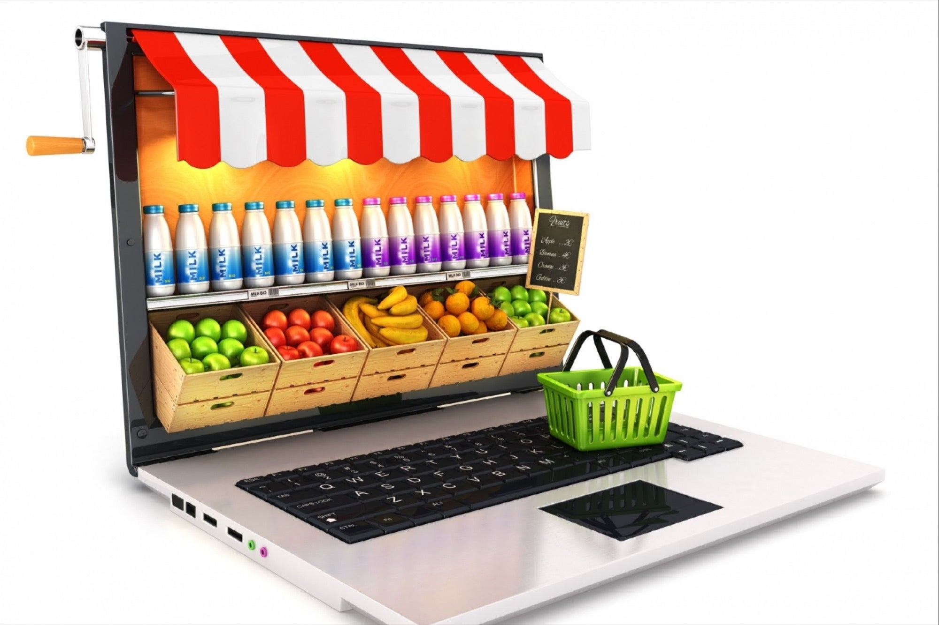

Instacart Market Basket Analysis
By
Ajith Leo

Slide 2
About Instacart
Maplebear Inc. doing business as Instacart, is an American delivery company based in San Francisco that operates a grocery delivery and pick-up service in the United States and Canada accessible via a website and mobile app.
It allows customers to order groceries from participating retailers with the shopping being done by a personal shopper.
Project Overview
To Analyse the Instacart orders Dataset to find the customer behavior, product popularity, order patterns, and departmental performance.The dataset includes information from over 3 million grocery orders from more than 200,000 Instacart users. It includes details on the sequence of products purchased, timing of the orders, and customer reordering behavior.
Tools Used:
Power Bi SQL Compiler

Slide 3
Key Business Question
1. How many orders by weekdays happen?
2.Which products are most ordered?
3.Buying pattern of customers
4.Which department should be focused to get new user?
5.Which product should be added to the department to get more orders.

Slide 4
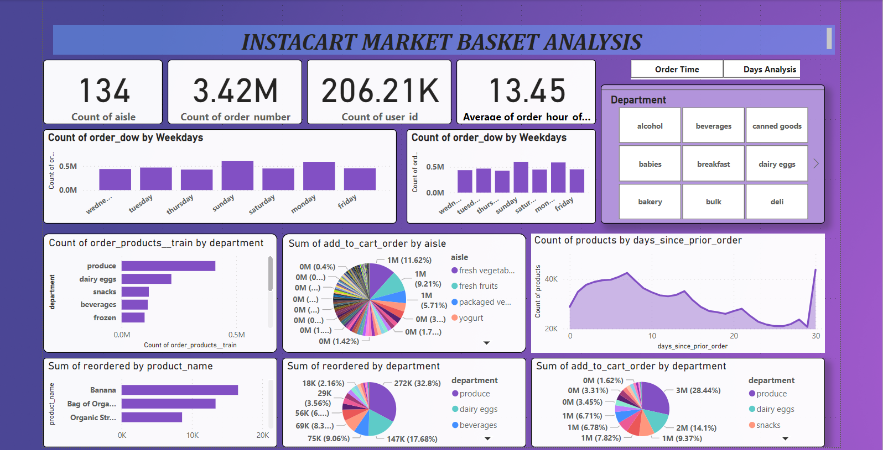
EDA-Market Basket Analysis

Slide 5
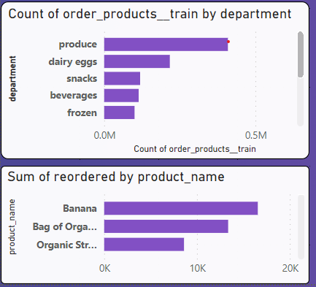
Top Products Orders By User
Banana and Bag of organic Bananas were reordered mostly by user.
In snacks, dairy eggs, and bakery department, biweekly consumption is high.

Slide 6
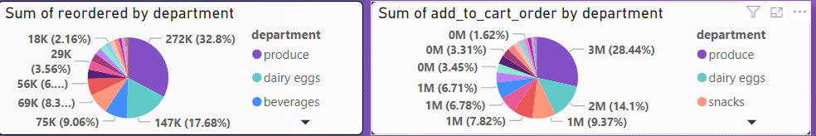
Department Analysis
The highest order, accounting for 32.8%, was recorded in the 'Produce' department. Within this department, both 'reordered' and 'add to cart' actions were recorded. Specifically, 'add to cart' accounted for 28% of the activity in the 'Produce' department. The 'Produce' department contains fruits, with fresh vegetables being the most ordered item."

Slide 7
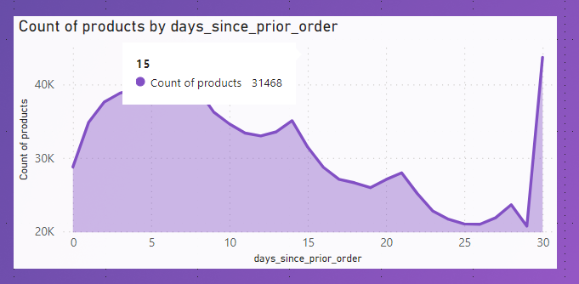
Products by days Analysis
On Sunday, it accounted for 17.56% of the count of order_dow. With a count of 600,905, Sunday had the highest count of order_dow, which was 40.95% higher than Thursday, the day with the lowest count of order_dow at 426,339.
Across all seven weekdays, the count of order_dow ranged from 426,339 to 600,905.

Slide 8
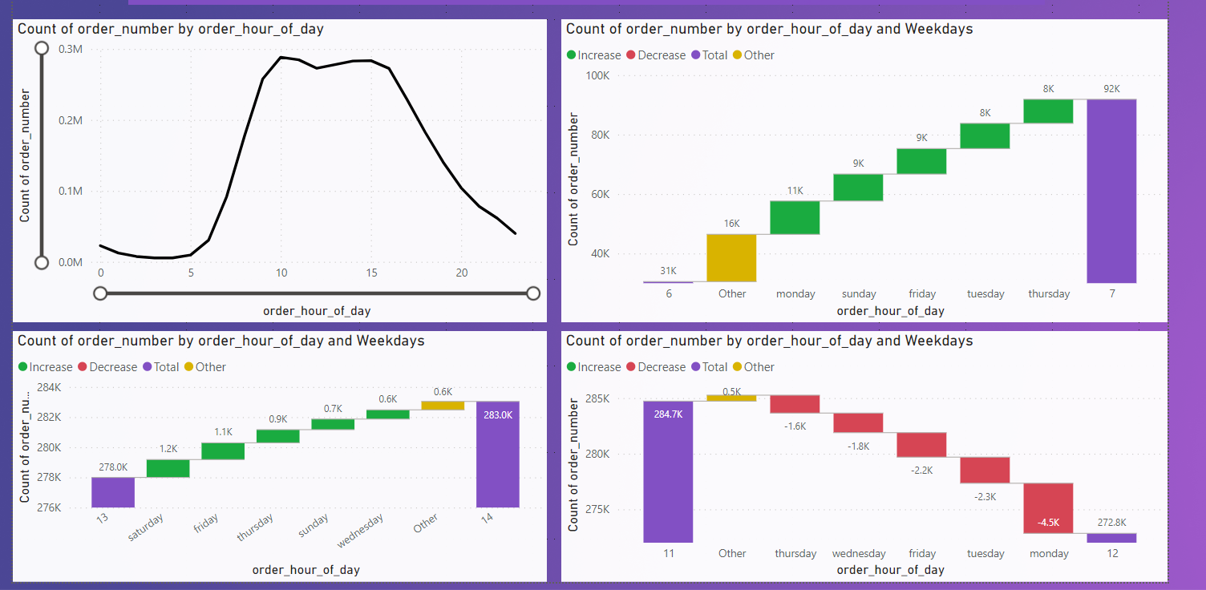
Order By Time Analysis
Most ordered time between 10.00 A.M to 13.00 P.M exhibited the highest count,,which recorded the lowest count at 5,474, by a margin of 5,168.87%.
Furthermore, orders at 10.00 A.M accounted for 8.43% of the total count of order_number.
Across all 24 order_hour_of_day segments, the count of order_number ranged from 5,474 to 288,418.

Slide 9
Findings & Recommendations:
After EDA analysis Instacart found that in the “ produce” department which accounts for most reordered by the department 50% of users from this department make “add to cart “ items are more. Instacart makes attention to create more visibility of the second most ordered department-” dairy products”.
The most preferred time by users is from 10.00 A.M to 12.00 P.M, sending pop-up notifications of new line products from these departments makes users increase their orders.
On Sundays only accounts for more orders when compared with other days. Instacart can create time-based campaigns according to the days of the week and hours of the day. For instance, night orders are low every weekday. Also, orders are decreasing when we close to the end of the week like Friday and Saturday.

Slide 10


